Slide 1
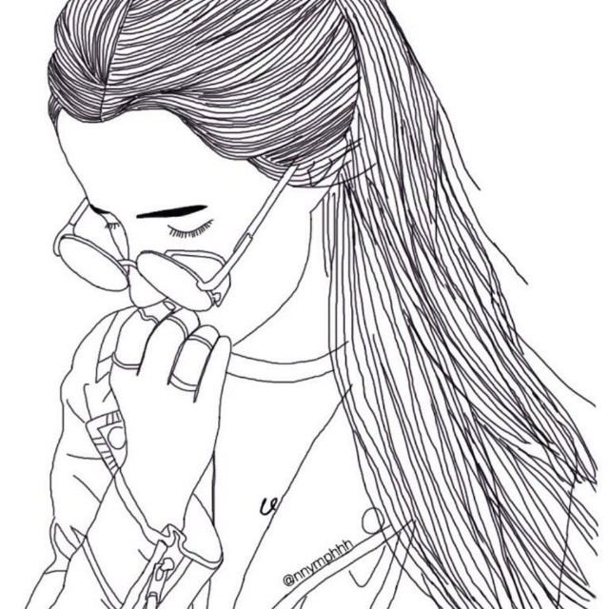
Safety Skills for Aspies
[Wallflowers are easy to pluck!]
2nd Annual Southeast Adult Autism Symposium
July 21st, 2018
Presenter: Dia Neighbors

Slide 2
Overview
Terminology
How we’re vulnerable
5 Responses to dangerous situations
How we exhibit trauma
Problems for women
Problems for men
Consequences for both
Solutions

Slide 3
What I mean when I say . . .
Sexual assault – Includes rape, inappropriate touching, sexualized bullying, and non-consensual sex between partners
Sexual abuse – long-term assault and manipulation including coercion and exploitation
Manipulation – Tricking someone in order to use them or steal from them; grooming for exploitation
Exploitation - the action or fact of treating someone unfairly in order to benefit from their work.
Aspie – someone with autism who retains the power of speech and has no intellectual disability (no ID)
Autistic person/person with autism – I use these terms interchangeably

Slide 4
Vulnerable vs. Weak
vul·ner·a·ble
adj.
susceptible to physical or emotional attack or harm.
(of a person) in need of special care, support, or protection because of age, disability, or risk of abuse or neglect.
weak
adj.
liable to break or give way under pressure; easily damaged.
lacking the force of character to hold to one's own decisions, beliefs, or principles; irresolute.
lacking intensity or brightness.
Notes:
vulnerable applies to us, but weak does not!

Slide 5
“Being a victim” vs. Being victimized
vic·tim
noun
a person harmed, injured, or killed as a result of a crime, accident, or other event or action.
a person who is tricked or duped.
vic·tim·ize
verb
to single (someone) out for cruel or unjust treatment.
Notes:
After this slide I am going to tell them my personal story in brief (with no graphic details), so they can know where I’m coming from and that I know what I’m talking about. Also, you rarely hear about the ways that “high-functioning” autistics are victimized when we navigate society on our own.

Slide 6
Disability and #MeToo
A Canadian study asked 95 adults with ASD whether they’d been sexually assaulted: 74 said yes.
78%
A British study found 9 out of 14 late-diagnosed Aspie women they interviewed had been assaulted:
64%
Disabilityjustice.org reports:
83% of women with disabilities will be sexually assaulted in their lives.
~80% of women and 30% of men with developmental disabilities have been sexually assaulted – half of these women have been assaulted more than 10 times.
Just 3% of sexual abuses involving people with developmental disabilities are ever reported.

Slide 7
Isolation
Attending events, venues, house parties without a group of friends. No protective layer of society for us.
Living and traveling alone.
Avoiding areas with lots of observers and potential witnesses.
Being female and alone in public spaces is particularly dangerous. Predators will automatically assume you are vulnerable.

Slide 8
“For those of us with fewer friends, it becomes a case of quality over quantity. We put a little more stock in each person. For us, friends are scarce and rare, and one can’t be easily replaced with others. This often makes us more vulnerable.”

Slide 9
Social confusion
We are socially shunned as children, so we never learn typical social cues and behaviors. We never model safety skills by spending time with more adept peers.
We can’t read other people well at all. It’s hard to recognize flirting or inappropriate comments and body language. We have difficulty figuring out other people’s needs and intentions.
The coping mechanisms and ”tricks” we’ve developed to blend in with NTs make us more vulnerable:
Mirroring
Camouflaging
Being a social chameleon

Slide 10
“Confusion in itself begets vulnerability. If you’re confused, you don’t know which way to turn. If you can’t see a potential bullet flying at you, you don’t know whether to dodge it or not; you don’t know which way to move. Until you can see it and you know which way to react, you’re vulnerable; the bullet is more likely to hit you.”

Slide 11
Lack of Information
Parents don’t want to think of a vulnerable child as a potential sexual being.
No comprehensive, evidence-based sex ed anywhere. And definitely none geared towards people with cognitive and developmental differences.
Incorrect information from online sources and pornography - instead of peers and experience

Slide 12
Social Status and Body Language
Predators are careful observers. Some signs of vulnerability they look for:
Regularly going to the same place unaccompanied
Literally standing against the walls, “orbiting,” being excluded from conversations and groups
How other people on the social scene or at work treat you; if you are spoken to seldom or disrespectfully, they know you are not likely to report them or be believed.
Body language and movements that tell them you are shy, defensive, uncomfortable, fidgety, or desperate for a friend or person to talk to

Slide 13
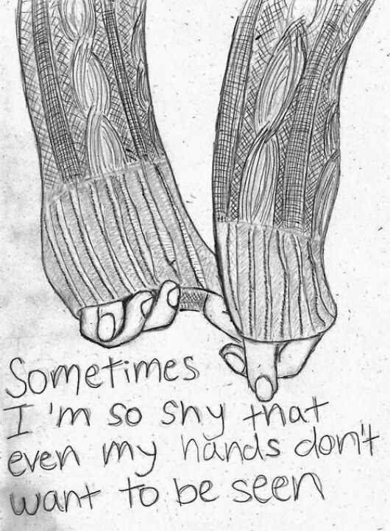
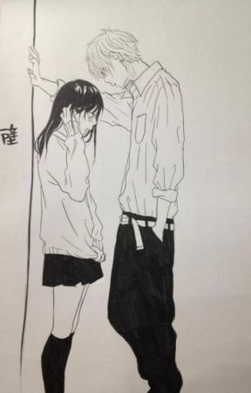

Slide 14
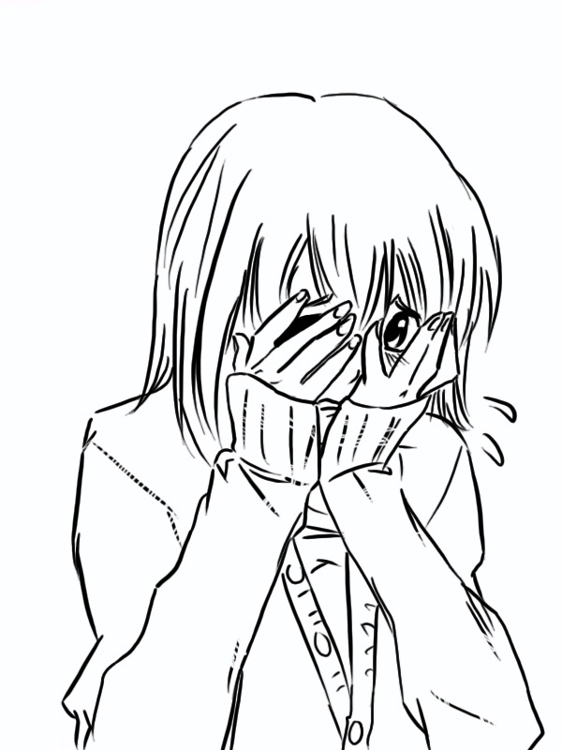
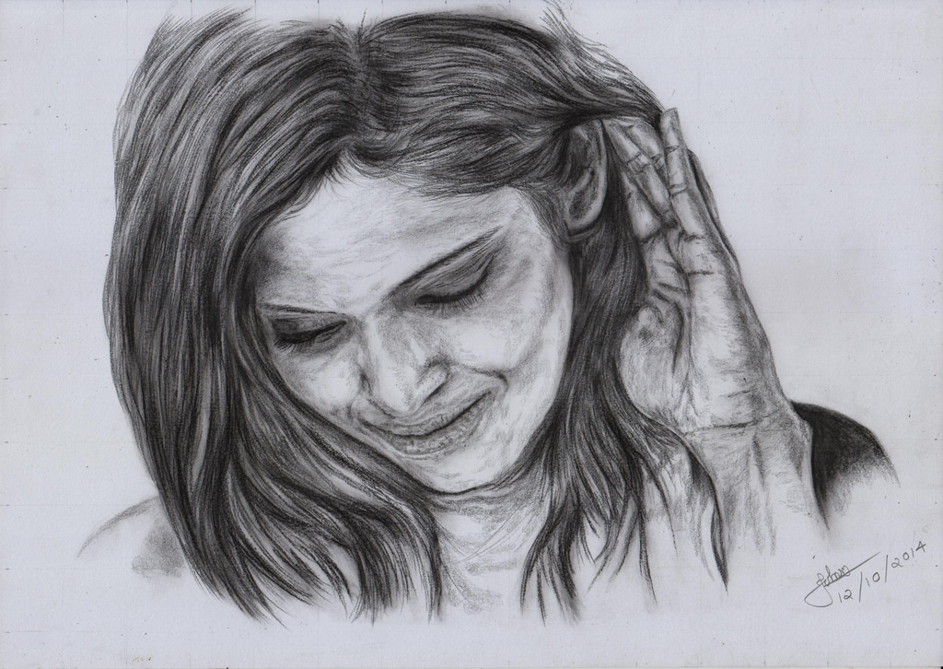
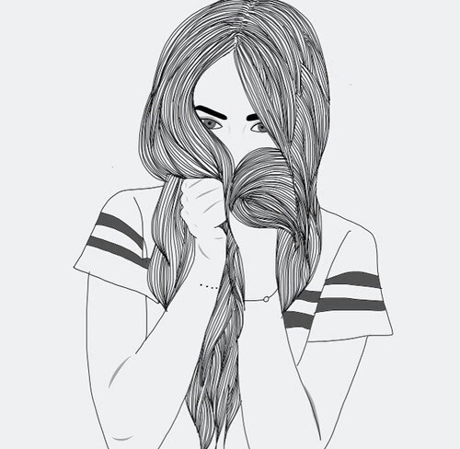

Slide 15
Misdiagnosis
Common misdiagnoses for Aspies are: bipolar I & II, major depressive, personality disorders
OR they only diagnose co-occurring issues: eating disorders, anxiety (general & social), depression, ADHD, learning disabilities, self-harm, trauma, oppositional defiant disorder
The wrong treatments and medications only put us at greater risk.
If you are misdiagnosed, you lack knowledge about how your brain works and it’s impossible to understand exactly how and why you are challenged. And what to do about it. Therefore, knowing about our condition, as soon as possible, and being educated about it is vital to our safety.

Slide 16
Compliance
From an early age spectrum people (especially girls) are socialized and trained to comply through:
Reward systems
Constant monitoring of our social presentation
Nagging, teasing, toxic shaming, exclusion, punishment
So we learn to:
Hide pain and discomfort
Never argue or disagree with someone
Never refuse a request
Please others at our own expense
Not tattle or “get someone in trouble”
“BE QUIET” and “DON’T BOTHER PEOPLE”

Slide 17
The 5 Responses to Danger
Everybody knows about:
Fight
Flight
But often those two are not an option, so we:
Freeze
Flop (play dead)
Friend (please & appease)

Slide 18
Autism and Trauma
The ways we react to trauma can be typical or atypical. Aspie assault and abuse victims can:
Isolate further
Rationalize the abuse or incident
Self-harm – often methodically
Develop eating disorders
Have more frequent shutdowns and meltdowns
Increase stimming and soothing behaviors

Slide 19
We can also:
Pathologically avoid coming into contact with the abuser, places where abuse happens, or triggers
Have increased anxiety, insomnia, depression, and suicidal ideation
Develop behavioral and substance addictions
Become promiscuous
Develop PTSD symptoms: flashbacks, night terrors, hypervigilance, paranoia, sensitivity to stimuli that wasn’t upsetting before

Slide 20
Barriers to Reporting Abuse & Assault
We can’t figure out who to tell or exactly how to tell them because of poor executive function and communication skills
We don’t trust anyone enough to disclose and have very small support networks – Sometimes the only person you would tell is the abuser
Denial by churches, schools, clinicians, employers, family, caretakers, and organizations

Slide 21
We can’t identify the fact that we have been wronged or traumatized
Fear of authority figures and officials
We feel like we won’t be believed or no one will care – and this is often correct
Few crisis centers that understand Aspies and our needs
Dependence on the abuser

Slide 22
Problems specific to women
Lashing in; not out. Instead of becoming conduct problems we are prone to taking it out on ourselves through self-harm, severe anxiety, withdrawal, substance abuse, and disordered eating
We are primarily targeted for sexual, physical, and emotional abuse – It’s all about power and control.
Lack of acceptance by female peers, so we socialize more with men
Cultural, social, and financial dependence on abusers

Slide 23
Problems specific to men
Much greater stigma for reporting abuse and assault
Men are primarily targeted for financial and emotional abuse. Sex and companionship are used for manipulation.
Lack of education about respecting boundaries and feeling entitled to a woman. This can lead to inappropriate actions and trouble with the law.
Learning about sex from pornography
Various sexual addictions

Slide 24
Problems for LGBTQ and Non-binary
Neurodiverse people are very diverse. There’s a significant overlap in autism and gender variance: One study found that participants on the autism spectrum were 7.59 times more likely to “express gender variance.”
Lack of study on this population
Double or triple the minority stress and stigma
Autistic trans youth have a really rough time transitioning and forming a secure identity.
Even more misunderstood and underserved than straight or cis Aspies
Even more bullying, assault, isolation, and estrangement
Especially sensitive to abuse
Sky-high poverty, homelessness, addiction, and suicide rates

Slide 25
The Consequences
Trauma and abuse exacerbate negative autistic traits and cause further developmental delays and worsening behavioral issues.
We aren’t considered “credible witnesses” so seldom is anyone punished or stopped. This allows abuse to continue longer.
Trauma and abuse lead to dangerous maladaptive coping mechanisms and co-morbid mental illnesses.
Self-harm and drug abuse are often used to “soothe” psychological trauma.
We develop extreme phobias and are unable to trust people in general - including people we need for help.
We stop asking for help altogether.

Slide 26
Suicide
In a British study from 2014, 66% of adults, diagnosed as adults, contemplated suicide. 35% said they’d planned or attempted it.
Finding the actual suicide rate for people with ASD is impossible, but autism families have been trying to bring attention to the problem for years.
Depression and suicide are not as linked in autistic individuals. We report suicidal ideation far more than depression.
Flash depressions and “the rabbit hole”
The risk of suicide in individuals with “mild” autism is about 10 times higher than in the general population. Women with autism are more likely than men on the spectrum to commit suicide.

Slide 27
Self-harm
The intentional, direct injuring of body tissue, done without suicidal intentions
Can be intentional and organized OR incidental to a bad meltdown.
An extreme form of stimming
A distraction from unbearable psychological and emotional distress
Often associated with repeated sexual assaults and sexual abuse
Common in Aspies, because we process pain stimuli differently as well

Slide 28
Solutions
Proper diagnosis and early intervention
Appropriate social communication lessons
Disability-friendly sex ed
Better transition services
Changes in attitude of neurotypicals
Cognitive Empathy improvement (on all sides)
Support groups for parents of ASD teens and transitioning adults
Continuing education for crisis personnel, teachers, clinicians, and law enforcement about ASD and vulnerability

Slide 29
How to raise a safer Aspie
Never force any social interaction, especially one involving physical contact, on a child. Even cute little toddlers have their boundaries and they should be respected. Never give a child the idea that the pleasing of others is more important than their personal comfort level. (Even in church).
Allow your child or teen to debate and disagree with you. They already do, but from a young age teach them how to do so respectfully and constructively.
Educate yourself on communication techniques and the requirements of Aspie teens and adults.
Speak to schools, police departments, clinicians, and other supportive professionals about the vulnerabilities of your spectrum person. Hold them accountable to reporting, transparency, and acknowledgement of the problem.

Slide 30
Sex Ed for the Spectrum
Relationship skills (learning empathy & communication)
Consent
Grooming and Dating
Assertiveness Training
Alternatives to a partner
Accurate information about everything else

Slide 31
What you can do to help
Push for an end to Abstinence-only sex education. 30% to 83% of disabled people experience sexual acts that they did not choose to have. Stop the shaming.
Form your own Aspie sex ed and dating skills programs where none exist.
Assertiveness and Self-defense Training classes for ASDs– teach us which situations are dangerous, to recognize “red flags,” how to refuse requests, how to negotiate, what to do and where to go and what to say if something bad happens, how to recognize being violated, etc.
INCLUDE us in your events, gatherings, conversations, and celebrations. We can be challenging and have different communication styles, but it’s worth it. Everybody needs to learn to accept the difference.

Slide 32
We need your . . .
Taxes and political will
Time and outraged concern
Talents and Expertise
Charitable Donations and Financial Advice
Votes for representatives who pledge to help the most poor, criminalized, and ill
Voice. If you know of injustices against the autism community, be a hero and speak out.

Slide 33
Sources

Slide 34
Websites and Organizations

Slide 35
Further Reading

