Slide 1


Using Social Media to Make Healthy Connections
Stacey Dixon, Ph.D.
Director of Behavior Supports
BlueCare Tennessee

Slide 2
Objectives
Know the benefits & pitfalls of social media
Understand the common “unwritten rules” for communicating on social media
Know how to avoid common risks for personal safety & privacy
Make plans for how to extend social media contacts into “real world” social settings
2

Slide 3

Social Media:
Potential Benefits & Pitfalls

Slide 4
Benefits of Social Media
Feeling connected to others
  Having conversation on a screen without having to attend to all of the tricky nonverbal social communication
  Getting to know people with less focus on outward appearances
Finding people with similar interests/values
Making friends
Getting information/opinions/advice 24/7
Sharing your own information/opinions/advice
4

Slide 5
Benefits of Social Media
In 2013 study*, among 108 adults with ASD:
  The majority (79.6%) used social media
  The most common reason was social connection
  Those who used social media were more likely to have close friends
  However, social media use alone was not associated with decreased loneliness
  * Social media use among adults with Autistic Spectrum Disorder. (2013) Mazurek, Micah O. Computers in Human Behavior (Vol. 29, Issue 4)
5

Slide 6

Benefits of Social Media
So, social media helps you make friends, but you have to engage in face-to-face interaction to decrease feelings of loneliness
6

Slide 7

Good Outcome Example
John is active in a couple of chat rooms about classic cars, which is a major interest of his. He goes to car shows, too, but he has a hard time initiating conversations and building friendships there.
He decided to ask the chat room participants where they are from. He found out that one guy lives in his home town. John asked if they could take their communication 1:1 to texting.
Through texts, they agreed to meet up at a local car show. This gave John someone to walk and talk with. His new friend is good at starting conversations, which helps John link with other car aficionados.
CHAT ROOM → TEXT 1:1 → COMMUNITY MEET-UP
7

Slide 8

Potential Pitfalls of Social Media
BULLYING: Biting/judgmental/abusive/offensive feedback and comments from your peers or from “Trolls”
  Can cause or exacerbate anxiety, depression, negative self-esteem
  Increases risk for suicide/homicide
8

Slide 9

Potential Pitfalls of Social Media
PREDATORS: People looking for those who are vulnerable to take advantage of or hurt you
  Why? Because they can
  This is their JOB, and they are EXPERTS
9

Slide 10

Potential Pitfalls of Social Media
Difficult to discern the accuracy of information
  Online, you can find “support” and “evidence” for any point of view
  “Fake news”
10

Slide 11

Potential Pitfalls of Social Media
Difficult to discern honesty/integrity/intentions of other parties
  News Flash: People LIE!
  “Love Bombing”
  “Catfishing”
  “Ghosting”
  “Cricketing”
  “Submarining”
11

Slide 12
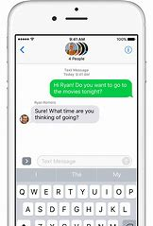
Opportunities for Social Learning
Practice the content of interactions
Use tools to check your perceptions, your use of terms and emojis, and the “unwritten rules” for social etiquette
  When in doubt, Google it
  Wonder what it means? Urban Dictionary
  Is it real or fake? FactCheck.org, Snopes.com
Ask someone for advice before hitting “Send”
Review a thread of conversation to see where
your communication worked and where it didn’t
12

Slide 13

Social Media:
Avoiding Risks to Safety & Privacy

Slide 14

Risks to Safety
People on social media can lure you in to:
  Exploit you
  Physically abuse or threaten you
  Sexually abuse or intimidate you
  Coerce you or your family
People can use information you give them to harass, embarrass or extort you
14

Slide 15
Decreasing Safety Risks
Don’t give out your address or take someone to your home until you have met them in safe places a few times
NEVER loan people money….no matter what reason they have for asking
Don’t give a Social Media “friend” any information or pictures that you wouldn’t give anyone else on the street
If you would be embarrassed for your family to see it, don’t share it!
You don’t have to share information about yourself that might make you seem vulnerable, an “easy target”
If someone is threatening you online, report it to law enforcement
15

Slide 16

Risks to Privacy
GPS tracking in mobile apps or posting where you are tells thieves you aren’t home
  78% of burglars use social networking sites to target homes
Every post, like, or click creates a digital footprint
Social media apps and sites collect data and share with third parties – unless you block them from doing so
Spam accounts – 71% of new accounts
Identity theft – 54% of social networking profiles have been targeted
16

Slide 17
Decreasing Privacy Risks
Remember: Screen shots are forever
Avoid posting your travel plans
Turn off tracking in apps
Create stronger passwords and change them frequently
Have different passwords for each social media site
  When possible, use two-factor authentication
Avoid logging into social media on publicly used computers
17

Slide 18

Decreasing Privacy Risks
Read privacy policies, especially related to “data collection” and “third parties”
Check your privacy settings
Think twice before clicking on links and installing apps
Don’t accept unknown connection or friend requests
  Know who you are talking to – check up on them!
18

Slide 19

Protecting Your Mental Health
Take breaks from social media
  Daily time limits
  No screen time 1 hour before bed
  Complete breaks
If it feels bad – STOP
Ignore trolls – responding makes it worse
Don’t ask people to “rate” your posts/Snaps
Ask someone you trust what they think is going right or wrong
Get help – no online communication is worth hurting yourself or anyone else
19

Slide 20

Social Media:
“Unwritten Rules”

Slide 21





Different Rules for Different Types of Social Media
21

Slide 22
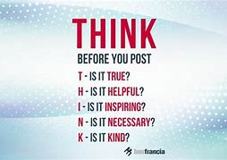
THINK Before You Post
22

Slide 23
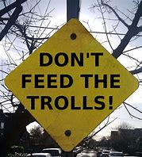
General Rules for Social Media
Screen shots are forever – Assume anyone can see what you post, both now and in the future
Erotic Pictures/Videos:
  Males – most females DON’T want to see it
  Females – most males DO want to see it
  IF someone asks for it, STOP & THINK – How could they use it? How could someone else use it? Is it worth it?
Reserve trust until you have met someone and see trustworthy behavior
You never have to respond
Remember that all social media is a means
of communicating something about YOU,
so is this post really what you want people
to know?
23

Slide 24
Snapchat Etiquette
A group Snapchat can be an icebreaker for 1:1 Snapchats or texts, which are more like real conversation
Don’t overdo “selfies” to people who aren’t your best friends, or you look conceited and desperate
Don’t Snap in the middle of a conversation with someone else –RUDE!
Don’t Snap pictures of what you’re eating – BORING!
Do Snap when you see something other people might find interesting (e.g., celebrity sighting, when you’re at a tourist attraction or fun activity)
Keep Snap stories to under 100 seconds
Don’t send too many Snaps a day, or you look like a stalker.
  Limit to 5 Snaps a day to a group or one person.
24

Slide 25
Snapchat Etiquette
If someone Snaps you, it’s rude not to Snap back
  But, wait for someone to Snap back before you Snap them again (called a double Snap)
If you’re dating someone, then having a yellow heart next to their name is a MUST – it means you Snap with them the most
Don’t screen shot other’s Snaps and post on other sites
If you have a crush on someone, wait 5 seconds before opening their Snap
If your crush doesn’t respond to you within 2 hours, they’re probably not into you
If someone’s bothering you or creeping you out, BLOCK THEM
25

Slide 26
Instagram Etiquette
Post only 1-2 photos a day, not the same subject repeatedly
Don’t “like” every photo you see – or everything one person posts
Ask permission before reposting someone else’s photo
Don’t use someone else’s photo without tagging them
Don’t comment and ask for a follow
Hashtags
  Don’t use them randomly – your message gets cluttered
  Use common hashtags to increase your connections with like-minded people
  Under 10 #s per post
  Check a site like Hashtagify for most popular or related hashtags
26

Slide 27
Facebook Etiquette
Only post to your wall what you want PUBLIC; otherwise use Message for personal information
  Don’t share personal, work, or relationship problems in posts
Don’t make friend requests to strangers
  If it’s a friend’s friend, you can ask for an introduction
You don’t have to accept all friend requests
Comment on your friends’ posts now and then, but not on all their posts or even every day
Reply to comments, especially if they are questions
Don’t update your status or post continuously throughout a day – take breaks
27

Slide 28

Facebook Etiquette
Repetitive themes make for boring walls
If you want to post controversial topics, get ready for arguments, offending people, and being unfriended
Don’t tag your (female) friends in unattractive photos
28

Slide 29

Twitter Etiquette
Keep it short and sweet!
Start out 4-5 tweets/day – don’t be a “noisy” tweeter
Respond personally, not via autho-generated or scheduled tweets
Switch from Twitter to text when ready for 1:1 conversation
Keep profanity to a minimum – be thoughtful and respectful
Avoid Twitter Wars and “flaming” – Don’t be a Troll!
29

Slide 30
Twitter Etiquette
Avoid minutiae – nobody cares what you had for breakfast
Use the @reply to publicly thank someone
Talk about other people more than yourself
  Show interest in others before asking them to care about you (or what you do)
  Ask questions
  Don’t beg people to read your blog or retweet you
Rein in your netspeak and abbreviations
  “lol” or “smh” is fine
  “omg jus chkd out th3 n3w Wwrld ep its kool” is infuriating
Hashtags - Limit to 2 per Tweet
30

Slide 31
Messenger & Texting Etiquette
Greetings are helpful, but not necessary
  “what do you have planned today”
  “wondered if you want to see a movie”
  “u up” = booty call…will likely get you shut down
ALL CAPS = SHOUTING!
Don’t correct others’ grammar or spelling
Not sure what they meant? Ask
Avoid excessive abbreviations – “how r u” – interpreted as lazy or immature
“K” or “uh huh” or “sure” – sound rude or uncaring
Don’t like exclamation points? Too bad! They are like a smile to the reader!
31

Slide 32

Messenger & Texting Etiquette
Type one thought at a time; better to send a short sequence of thoughts rather than one long text
If someone doesn’t respond, they might:
  Be driving
  Be busy
  Not into you
If you try again in a couple of hours and they still don’t respond, let them be the one to make the next move
Use emojis to set the tone and alleviate sarcasm
32

Slide 33

Messenger & Texting Etiquette
If the conversation is long or complex, ask if you can call instead
Never, never, NEVER break up with someone via text/IM
No drunk texting
One IM nudge or buzz is the limit – multiple nudging is annoying
On IM, set your status as busy/away when unavailable, so people don’t get mad when you aren’t answering
Clear endings are helpful
  Goodbye
  TTYL – “talk to you later”
  BRB – “be right back”
33

Slide 34

Your Examples: Lessons Learned
34

Slide 35

Your Questions: “Unwritten Rules”
What does that mean?
What should I do if……?
Now what do I say?
Should I….?
35

Slide 36

From Social Media to “Real World” Settings

Slide 37

The Pitch
Start with the next step and work your way up:
  If on Snapchat, Instagram, or Facebook → Text/Message
  If texting → Phone call
  If phone call → Skype or invite to meet in person
Have the invite in mind
  Where
  When
  Doing what
  How to get there (Going together? Meeting
  there?)
  Who else will be there, if this applies
Follow up with a text the day before or the
morning of the meet-up (e.g., “Hey, you still up
for lunch today?”)
37

Slide 38
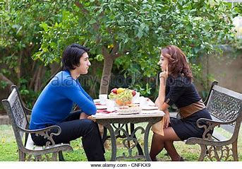
The Meet-Up
For safety, start in public space before meeting privately
  Somewhere quiet enough for conversation
  Doing something BOTH of you enjoy
  Plan on first meet-up lasting about 1 hour, unless the planned activity is longer
Start with a greeting, a smile and a light compliment
  “Hey, it’s good to finally meet you!”
Figure out together where you will sit or get started
38

Slide 39

The Meet-Up
When in conversation, remember:
  People like being listened to more than they like listening to you
    Ask questions about COMMON themes (e.g., movies, pets, jobs, the weather) – don’t get too personal
    Ask follow-up questions before sharing your opinions
  Take turns in talking about your interests/likes/dislikes – no more than 2-3 sentences
  Avoid voicing strong opinions about:
    Religion
    Politics
    When you disagree with the other person’s opinion
  Eye contact, eye contact, blink, look away, back to eye contact
39

Slide 40

The Meet-Up
Time to go!
  Say you enjoyed meeting them
  If you want, ask if they would like to get together again sometime
    If they say yes, ask what are good days/times
    If they hesitate, it means they don’t want to get together (so say “no pressure” or “just let me know if you do” to let them off the hook)
  Physical contact (handshake, hug):
    Only do what you feel good about
    Best to wait for the other person to initiate it
    No more than 5 seconds
  Wrap up statement, smile, and walk away:
    Thanks, again!
    Bye, now!
40

Slide 41
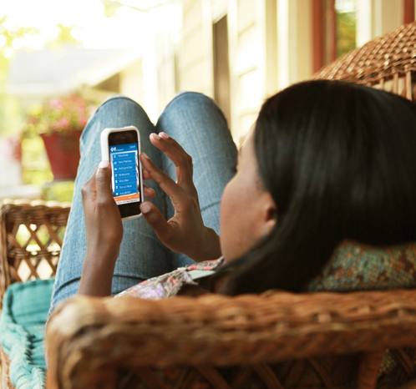
The Follow-Up
If the meet-up didn’t go well, you don’t have to stay in contact with the person
If it did go well, text/message the next day:
    “Really enjoyed yesterday. Hope we can
    meet up again sometime”
    If the person says “K,” “yeah,” “uh huh,” OR
      if they don’t respond, they probably aren’t
      into you
      Wait to see if they respond more positively
      If not, don’t keep trying
If the person responds with a full text, they are
probably interested
  Follow-up with a specific invite at least 1 week in the future
41

Slide 42

1 Cameron Hill Circle | Chattanooga, TN 37402 | bluecare.bcbst.com
BlueCare Tennessee is an Independent Licensee of the BlueCross BlueShield Association

