Slide 1
The Importance of Healthcare Screenings
Scott Kramer, MSEd - Program Director, GCA Centre for Adult Autism/
Community Resource Specialist, Arc TN
Elizabeth Huitz, RN – Vanderbilt University
(wrote portion on healthcare screenings other than colon cancer)

Slide 2

Ice Breaker
How many of you are proactive when scheduling healthcare screenings (e.g. colonoscopy scan)?
What feelings do you get when you hear about getting a healthcare screening? What feelings provoke you?
If you knew when you should consider getting a healthcare screening, would you be more likely to follow up and have your screenings?

Slide 3
What To Expect From This Presentation – Learning Objectives
Learning Objectives:
1. Understand the importance of getting health screenings and Scott’s story
2. Know the different types of health screenings
3. Identify where you can find resources in your area that you can access

Slide 4

LO 1 - Understand the importance of getting health screenings
1. One Body, One Life
Be Proactive, Not Reactive
Reactive = Bad Things Can Happen
Proactive = Good Things Can Happen

Slide 5

Setting the Scene
“PREMATURE MORTALITY IN AUTISM SPECTRUM DISORDER”
The British Journal of Psychiatry (2016)
Longitudinal Study (1987-2009) – ASD adults dying an avg. of 17 years earlier
Karolinska Institutet, Stockholm, Sweden - Matched Case Cohort Study (ASD and non-ASD cohorts)
COHORT STUDIED | TOTAL NUMBER IN STUDY | NUMBER OF MORTALITIES | MORTALITY % OF COHORT STUDIED | MOST LIKELY TO DIE SOONER
General Population | 2,672,185 | 24,358 | 0.91%
ASD Population | (Diagnosed) 27,122 | 706 | 2.66% | 2.92 time higher¹
¹ Suicide - leading cause of HFA deaths

Slide 6
Setting the Scene
“PREMATURE MORTALITY IN AUTISM SPECTRUM DISORDER”
ASD Population | (Diagnosed) 27,122 | 706 | 2.66% | 2.92 time higher¹
¹ Suicide - leading cause of HFA deaths
Reasons for suicide for the autism community at large
Lack of support system (via this study)
Lack of medical care (my reason)

Slide 7
Setting the Scene
Relation to Approximate Adult Autism Population in Tennessee and Chattanooga
CDC (2018) says 1 in 40 on the autism spectrum (2.5%)
 | Tennessee (1) | Chattanooga (1) city
U.S. Census Bureau, Population Estimate, July 1, 2017(1) | 6,715,984 | 177,571
% are ASD indivs (2018) (2) | 2.5% | 2.5%
Approx. # of ASD indivs | 167,900 | 4,439
X % over 18 (US Census, 2017) | 77.1% | 77.1%
Approx. # of ASD Adults, 18 and older | 129,451 | 3,422

Slide 8
Setting the Scene
Relation to Approximate Adult Autism Population in TN,GA, AL, AND NC
CDC (2018) says 1 in 40 on the autism spectrum (2.5%) (2)
 | TN | GA | AL | NC
U.S. Census Bureau: Population Estimate, 2017 (1) | 6,715,984 | 10,429,379 | 4,874,747 | 10,273,419
% Who Are ASD Individuals, 2018 (2) x | 2.5% | 2.5% | 2.5% | 2.5%
Approximate # of ASD Individuals | 167,900 | 260,734 | 121,869 | 256,835
% of people, 18 and Over in US, 2017 (1) x | 74.0% | 75.9% | 77.5% | 77.6%
Approximate # of Adult ASD Individuals | 124,246 | 197,897 | 94,448 | 199,304
https://www.census.gov/data/datasets/2017/demo/popest/state-detail.html#par_textimage_2063038847

Slide 9
Scott’s Story
▪ Officially diagnosed on the autism spectrum at age 40
▪ Received colon cancer diagnosis (Stage III-B) at age 50 (teenagers can be diagnosed with colon cancer – example of 17-year old girl)
- resection of colon (large intestine)
- port surgery
- eight rounds vs. twelve rounds of chemo (Folfox)
▪ ~ 75% survival rate - 3 years in remission w/ clean colonoscopy scans
▪ Up to 9% additional survival rate with positive changes in exercise and diet

Slide 10
Scott’s Story
Keys To Success
Support system (informal survey follows) – online and in-person
Change in diet and exercise after finishing chemotherapy/recovery
Following oncologist/oncology nurse instructions – getting second opinion when needed
Keeping oncologist informed about changes taking place within you

Slide 11
Scott’s Story
Keys To Success - #1 Support System
Outside of an online colon cancer support group, how many people in your "inner circle" (family members, friends, others close to you) are a part of your support network? (n=90 cancer patients/survivors reported)
- Over 50% had in-person support between 1 and 10 people
Outside of an online colon cancer support group, how many people in your "inner circle" (family members, friends, others close to you) are a part of your support network as a caregiver? (n=33 caregivers answered)
- Over 63% had in-person support between 1 and 5 people

Slide 12
Scott’s Story
Keys To Success - #1 Support System
My theory with regard to autistic adults when encountering cancer:
Support system in place prior to cancer = same with cancer
NO support system prior to cancer = struggle with cancer
Cancer is a disease that can be unpredictable. Knowing what will happen is HUGE! Having people to support you is MORE HUGE!

Slide 13
Scott’s Story
Keys To Success - #2 Change in diet and exercise after finishing chemotherapy/recovery
- No inheritance of cancer (vast majority from survey)
- Culprit 1: Western “fast food” diet – go to more Mediterrean/plant-based diet
- Culprit 2: Lack of physical exercise (accommodate for those with physical limitations) – 30 minutes a day minimum, 5 days a week is optimal

Slide 14
Scott’s Story
Keys To Success
#3 Following oncologist/oncology nurse instructions
Issue: Wanting to cut back (on drugs/# of treatments)
#4 Keeping oncologist informed about changes taking place in you
Issue: “Shards of glass”
_________________________________________________________
Update: In May 2018, the American Cancer Society….
Start regular screenings at age 45 (down from age 50)
Start < age 40 for those considered “high risk”
▪ Family history, Crohn’s disease, certain polyps/personal history

Slide 15

Check Ups Are Important!
Start by establishing care and maintaining annual visits with a primary care doctor.
This allows education to prevent problems before they begin.
Early detection of health care problems leads to better outcomes.
Individualized health care plan based on you as an individual.

Slide 16

Body Weight Monitoring
Physician can monitor your body weight and BMI to determine if your weight is healthy for your age and body type.
Waist circumference can be measured for further health information
This is one of the most basic measurement that can be taken to track one’s health and any major changes.

Slide 17
Blood Pressure Screening
Ideal blood pressure is 120/80* or below. Keeping track measurements annually again allows for changes to be tracked.
*120 (Systolic heart rate) = measures pressure in your
blood vessels when your heart beats
*80 (Diastolic heart rate) = measures pressure at rest
Causes of hypertension can be stress, diet and exercise, or sometimes even an underlying health cause such as kidney disease.
High blood pressure (hypertension) can be modified through diet, exercise and medications.
Prolonged untreated hypertension can lead to atherosclerosis which causes coronary artery disease (narrowing of blood vessels caused by plaque build up).

Slide 18
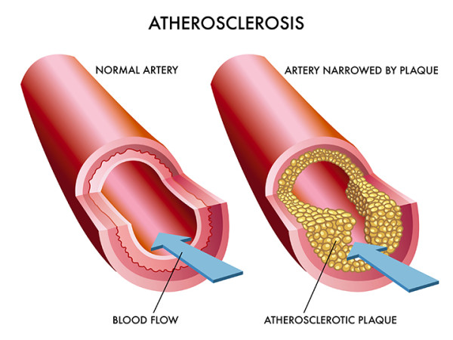
Cholesterol Screening
Screenings should begin by the age of 20 (sometimes done even earlier) and should be done at least every 5 years.
Assessing cholesterol levels can determine individuals at risk for heart attack, stroke and other serious complications.
High levels of cholesterol can lead to “atherosclerosis” which is the narrowing and stiffening of blood vessels which causes difficulty of blood flow due to the narrowing of passage.
One leading cause of atherosclerosis is hypertension.
Onset is gradual and symptoms are often undetected unless discovered during health screenings.
There are many complications of hypertension and high cholesterol levels and many of the complications go hand in hand.

Slide 19
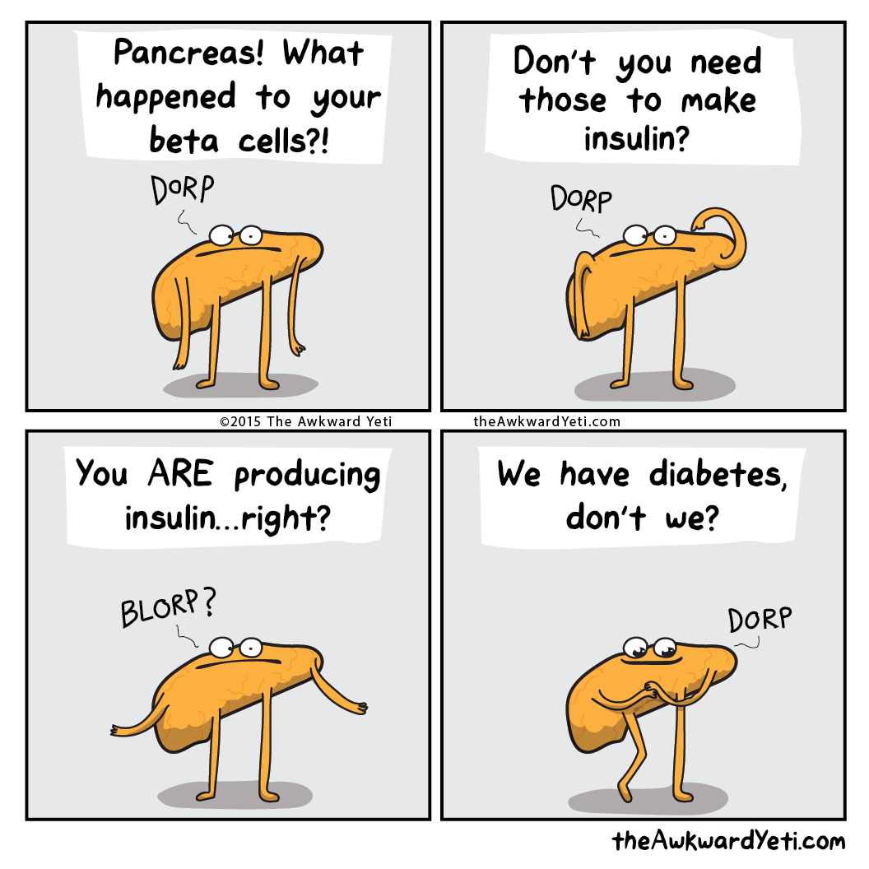
Diabetes Mellitus
At what age an individual should start being screened depends on risk factors; ie: age, gender, BMI, ethnicity and family history.
Otherwise healthy individual should begin screenings by the age of 45.
Type one diabetes is referred to as juvenile onset caused by body attacking pancreas which leaves body unable to produce insulin (regulator of blood sugar).
Type 2 diabetes is caused by prolonged hyperglycemia (high blood sugar) leaving body insulin resistant.
Onset is slow and gradual, symptoms are many times not detected unless caught during health screenings
Many complications caused by untreated diabetes

Slide 20

Take Action!
Be educated, keep up to date with your annual visits and health screenings to determine if you are at risk.
Make healthy and active l
Some healthy choices that are recommended may include: maintain healthy body weight, healthy diet (increase fruits, vegetables, whole grains and decrease processed foods and added sugar), reduce sodium intake, smoking cessation, decrease/eliminate alcohol intake, increase physical activities, improve stress levels.

Slide 21

Noteworthy Screenings to Discuss with your provider
Breast cancer screening, prostate cancer screening, colonoscopy screening.
Sexually Transmitted Diseases, Sexually Transmitted Infections.
Psychological screenings
Osteoporosis
Chronic Kidney Disease
Thyroid Disease
Dental visits!!

Slide 22
LO 3 - Resources
Resources
Free & Income Based Clinics in the USA
https://www.freeclinics.com
Free Screening Colonoscopies (ACA)
http://stopcoloncancernow.com/colonoscopy/free-screening-colonoscopies
3. Colonoscopy Cost for Insured
http://stopcoloncancernow.com/colonoscopy/cost-of-a-colonoscopy/colonoscopy-cost-for-uninsured

Slide 23
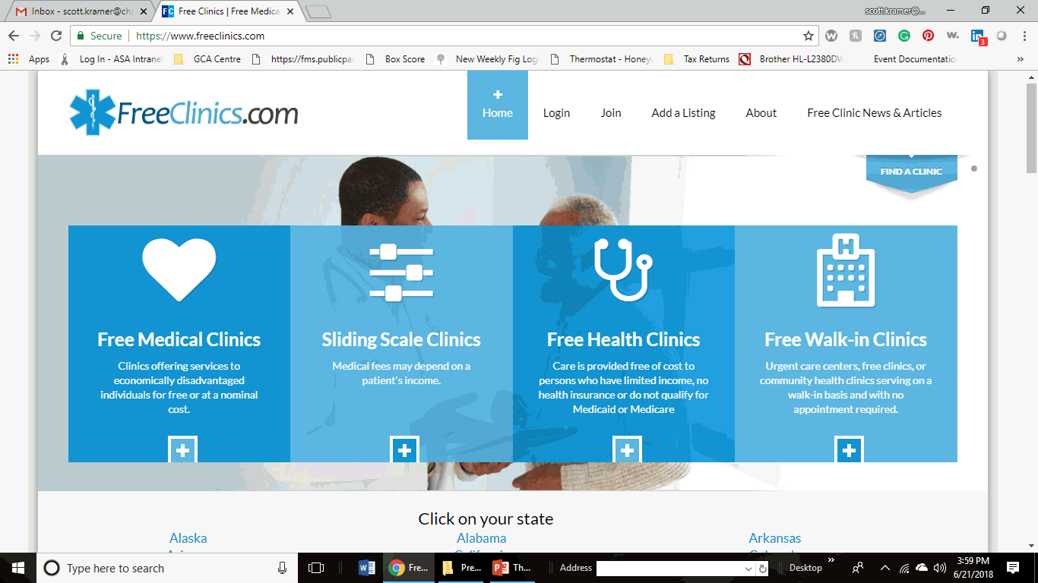
LO 3 - Resources
Resource 1 - Free & Income Based Clinics in the USA
https://www.freeclinics.com

Slide 24
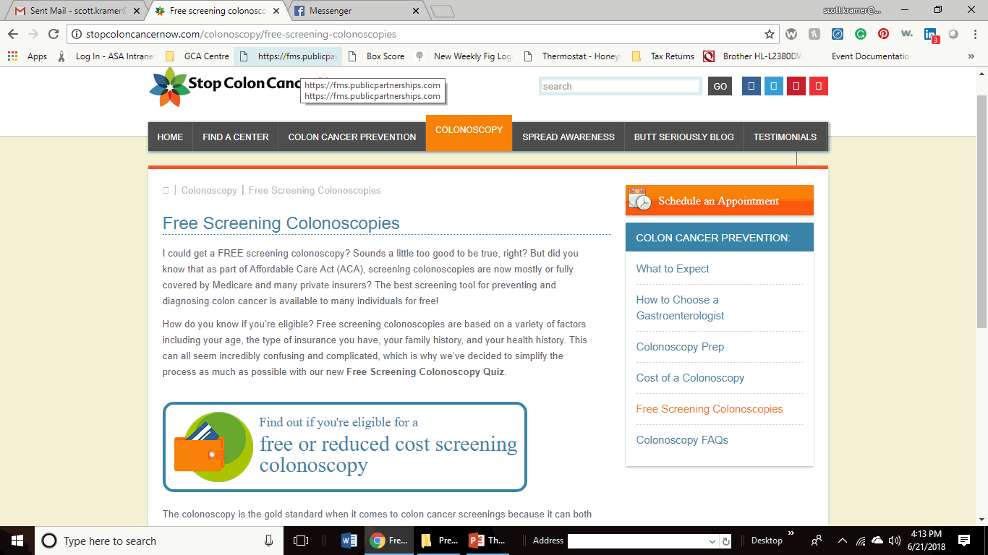
LO 3 - Resources
Resource 2 - Free Screening Colonoscopies (ACA)
http://stopcoloncancernow.com/colonoscopy/free-screening-colonoscopies

Slide 25
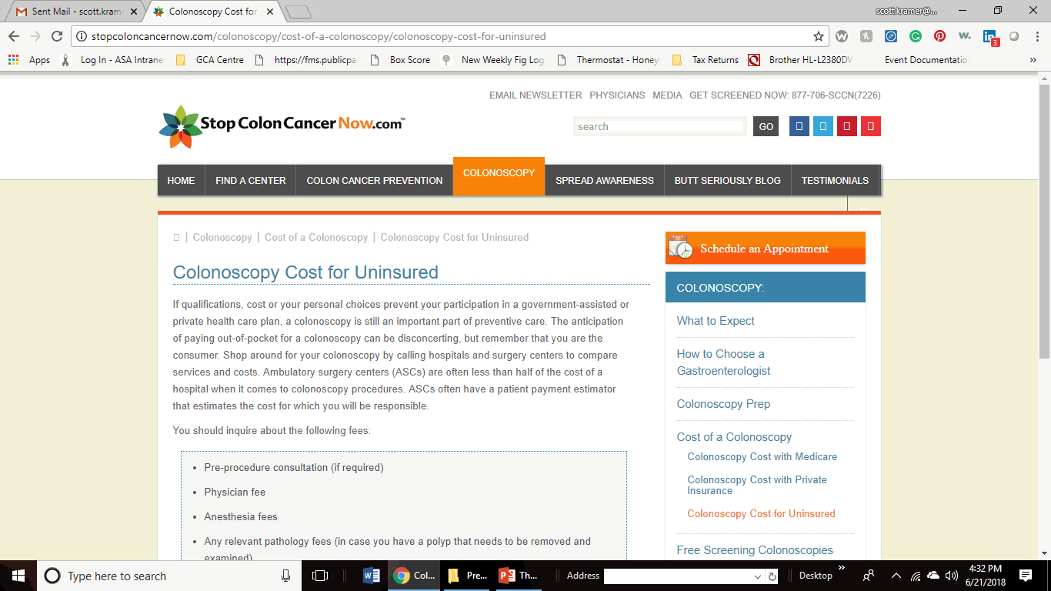
LO 3 - Resources
Resource 3 - Colonoscopy Cost for Insured
http://stopcoloncancernow.com/colonoscopy/cost-of-a-colonoscopy/colonoscopy-cost-for-uninsured

Slide 26
Contact Information
If you have any further questions please feel free to contact us –
Scott Kramer
Program Director, GCA Centre for Adult Autism
Email: scott.kramer@chattanoogaautismcenter.org
Community Resource Specialist, The Arc of Tennessee
Email: skramer@thearctn.org
Elizabeth Huitz
Neurology Research RN
Vanderbilt University Medical Center
Email: elizabeth.huitz@vumc.org

