Slide 1
Julie Cox, LICSW, CGRS
1300 East Main Street
Suite D
Prattville, AL 36066
334-730-0909

Slide 2
Robert Watkins, Autism Advocate

Slide 4
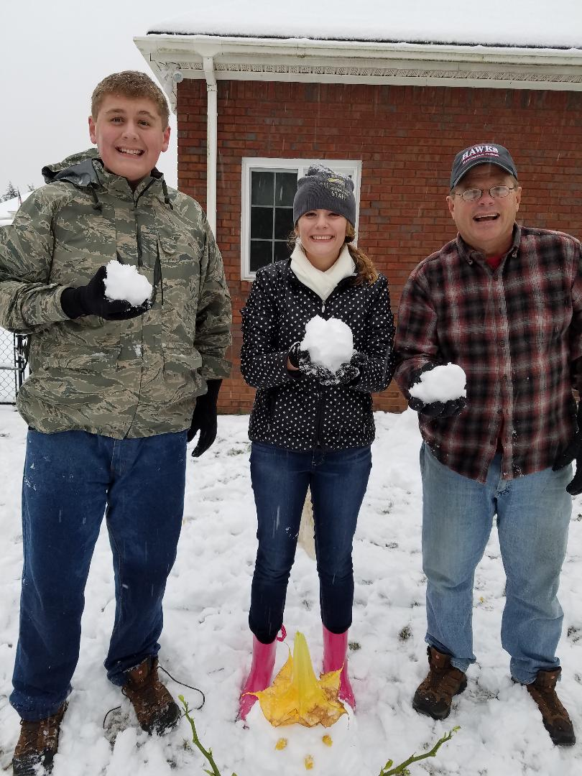
In Honor of:
My Family

Slide 5
The Grief Recovery Method was created to help complete your relationship to the pain, isolation and loneliness caused by significant emotional loss. Recovery is achieved by a series of actions made by the griever. Completeness occurs as the result of having delivered those emotional communications that either were not made, were never heard or need to be said again.

Slide 6
A Parent’s Perspective offers therapeutic services geared toward the parents of children/adults with physical/emotional needs. Services include shared experiences through groups, building on family strengths, problem solving and exploring needs. Social Work Solutions is the only provider in the River Region with experience in providing therapeutic services to individuals and families with ASD.

Slide 7
What is Grief
Grief is the _______Conflicting_______ feelings caused by the end of OR change in a familiar pattern of behavior.
Grief is what you think and feel on the inside.
Examples of grief feelings

Slide 8
What is Mourning
Mourning is the outward expression (the action) of your thoughts and feelings. It is the cultural response to grief.
Examples of mourning

Slide 9
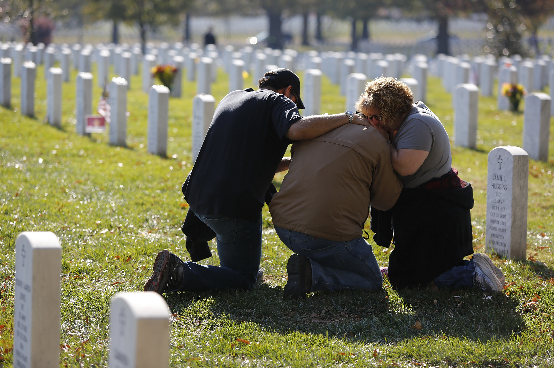
To mourn is to be an active participant in grief

Slide 10
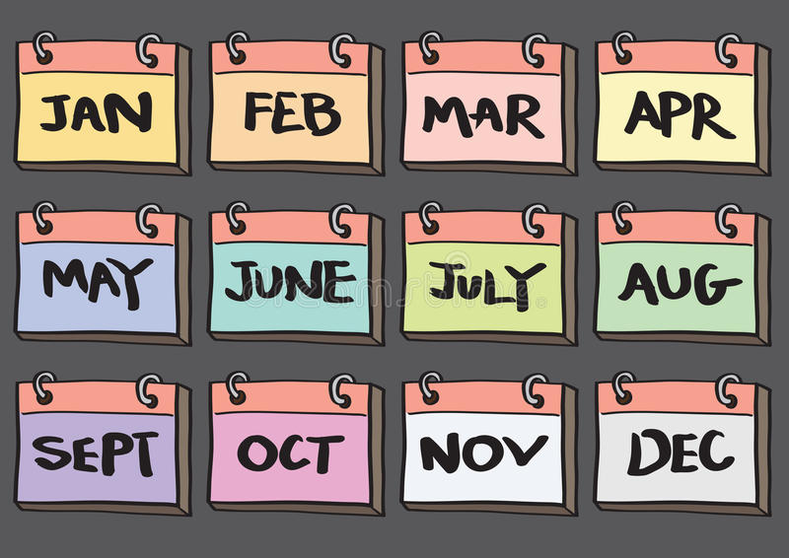
Bereavement- The process of adjusting to the loss
Secondary Grief- loss caused by grief event

Slide 11
Causes of Grief/Secondary Grief
Death Divorce Health
Car Accident Loss of Job Finances
Move Deployment Separation
Empty Nest Relationships Pet
Expectations Infertility Miscarry
Safety/Security Faith Addiction
Retirement Legal Problems Holidays
Transitions Mental Illness Children Problems
Shared Grief Uncontrollable Events Traumatic Events
Anniversary Dates

Slide 12
Types of Grief
Normal- simply, your way of grieving
Anticipatory- you know it is coming (hospice, long term illness, old age)
Disenfranchised/Unauthorized- society deems the loss invalid, insignificant or stigmatized

Slide 13
Ambiguous- Hard to pinpoint, hard to define
Exaggerated- Cumulative (mom dies, lose job, friend leaves town)
Delayed/Absent- Logical thing to do, profound, unable to cope
(planning the funeral arrangements, make the phone calls)
Masked- Unable to recognize
how grief manifests in life

Slide 14
Chronic- Refuse to grieve, obsess, interferes w/life
Abbreviated- Short lived, happens quickly (lack of connection to the event or replaced quickly)
Inhibited- Physical symptoms occur, difficulty expressing feelings

Slide 15
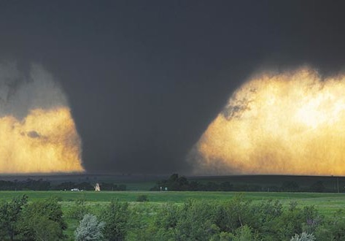
Collective-Group of people, organization shares the same experience

Slide 16
Myths/
Intellectual Comments
Don’t Feel Bad
Replace the Loss
Grieve Alone
Be Strong
Keep Busy
Time Heals All Wounds

Slide 17
Don’t feel bad, she is in a better place
You can get pregnant again
She needs time alone

Slide 18
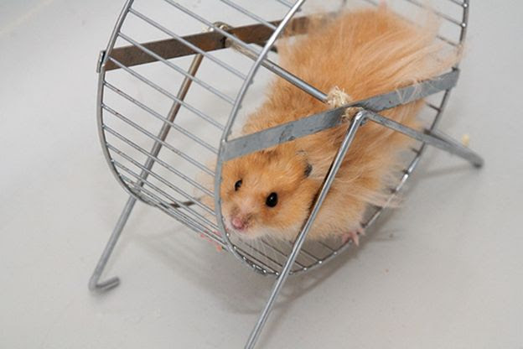
Be strong for the children
Try helping other people in worse situations, you had him for 45 years
Next year this time, you will feel much different.

Slide 19
BIG HEART WITH BIG EARS

Slide 21
Don’t hide your own grief
Grief is normal
Get support
Remember your loved one
Watch for warning signs

Slide 22
Autism and Grief

Slide 24
Kicked the bucket/Bought the farm
Put to sleep/Rainbow Bridge
Went to see Jesus/Earned his wings
6 Feet under/Pushing up daisies
Gone to a better place/At peace
Euphemisms for
Death

Slide 25
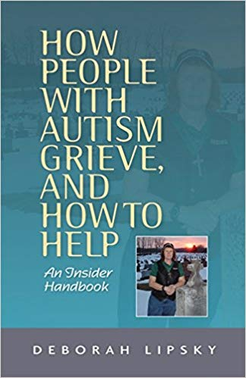
Emotional Differences in Dealing with Problems
Expressions of Grief in Autism
Cultural Expectations and Autism
Knowing What to Say
How to Tell a Person with Autism Someone Died

Slide 26
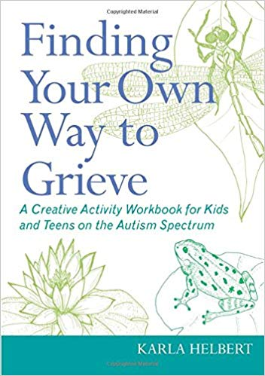

Slide 28
Questions

Slide 29
Julie Cox, LICSW, CGRS
1300 East Main Street
Suite D
Prattville, AL 36066
334-730-0909

