Slide 1
Reaching Beyond Everyday Social Interactions; Dealing with “Difficult” People
Saturday, July 21, 2018 2nd Southeast Adult Autism Symposium

Slide 2
Dave Griffin, M.Ed. Introduction
Teen & Adult Project Coordinator, Autism Tennessee
B.A., Political Science, Duke University, 1989
M.Ed., Secondary Education, Vanderbilt University, 1994
Consultant to Spectrum Pathways, Vanderbilt University, 2016- present.
Board Member, Empower Tennessee, 2017-present.
Project Specialist, The Arc Tennessee, 2016-present.

Slide 3
Objectives
Create a plan to identify a support system of neurotypical peers to reference for guidance
Explore negative emotional responses that impede the development of social skills
Understand key problem areas of social interaction to improve social skills

Slide 4
Objectives Continued
Identify opportunities to practice social skills in socially acceptable ways.
Identify difficult situations in the work environment and other contexts.
Share effective strategies for coping with difficult situations

Slide 5
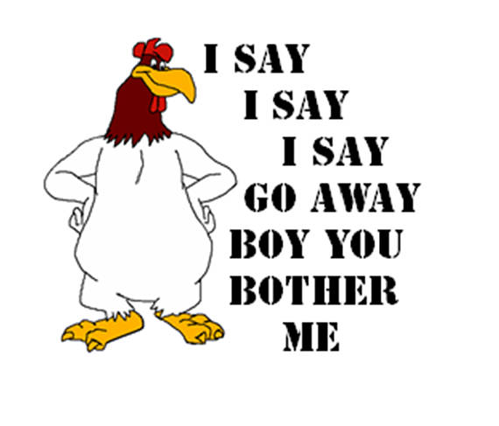
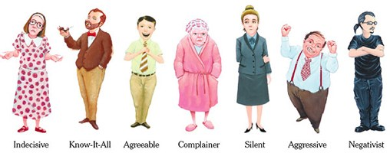
Who are Difficult People?

Slide 6
How have I dealt with difficult people in the past?

Slide 7
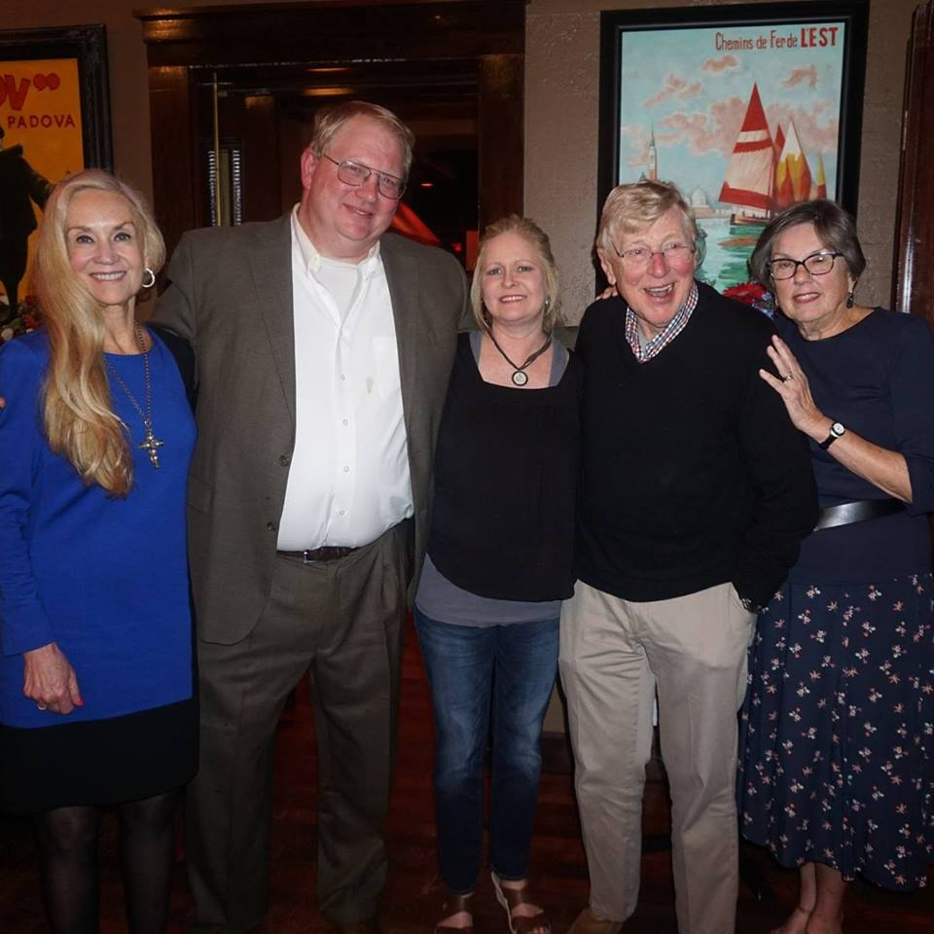
Establish a Foundation of Support

Slide 8
Professional Mental Health Provider

Slide 9
Anne Carrie Ginger Babs Juanita

Slide 10
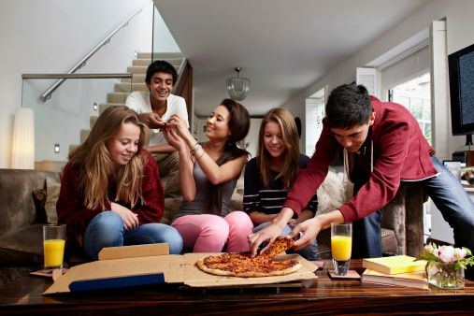
Asking Neurotypicals for Help

Slide 11
Respect The Boundaries of Your Allies
Respect Their Time
Accept No For
An Answer
Say Thank You
Reciprocate

Slide 12
Practicing The Basics Of Social Skill Development
Communication
Context
Self Presentation
Self Awareness

Slide 13
Communication
Volume and interrupting
Light topics (e.g. the weather)
Respect others time
Let others talk

Slide 14
Context
Professional
Talking across gender
Public
Private

Slide 15
Professional

Slide 16
Personal

Slide 17
Self-Presentation (Juanita Simanekova with professional partner Jonathan Chen)

Slide 18
Developing Skills for More Difficult Situations

Slide 19
De-escalation Techniques
Defer: Put off to a later time; postpone.
Disengage: Disconnect from a relationship either in part or completely

Slide 20
Some Specific personality types and situations

Slide 21
Avoidant People
Reach out appropriately. Frequency depends on situation and context. Typically you should wait 2-5 business days before reaching out again.
It is up to the other to let you know when it is too often. Ask allies for help when the boundary is unclear.
Have a plan in case they do not respond.

Slide 22
Angry Screamers Gently say no to the volume. Gently say yes to the communication.
..

Slide 23
Inflexibility
“Please know that I am only interested in following your directions and being the best worker I can be for you. With that said, I would request that you re-consider my requests for accommodation. Otherwise, I will struggle to furnish you with the accountability you need.”

Slide 24
Invalidators
Being on the spectrum does not free me from being held to the same standard.

Slide 25
Bullies
“I am presented here with an ultimatum in which I am being asked to perform a duty which is dangerous to my emotional and perhaps my physical health. I consider myself a valuable employee and do not want to compromise my well-being. What options can we discuss?”

Slide 26
Your supervisor’s supervisor

Slide 27
False Accountability
“I don’t recall that.”
“That may be true.”
“I don’t think it is appropriate to take credit for something I have not done.”

Slide 28
Those Who are “Never Wrong”
Asperger's v Narcissistic Personality Disorder

Slide 29
The Narcissist You Know Joseph Burgo

Slide 30
Dr. Douglas is in the middle……

Slide 31
Tips for Others
Accept constructive criticism.
Show willingness to work hard.
Ask employers to “carve” a position----one that plays to your strengths.

Slide 32
Skills Into Practice
Conversation with an Ally
Conversation with a “Difficult” Person

Slide 33
Appropriate Conversation with an Ally
Take turns
Don’t monopolize with questions or information about yourself.

Slide 34
Appropriate Conversation with a “Difficult” Person
Save for later.
Say as little as possible.
Don’t argue.
Take notes.

Slide 35
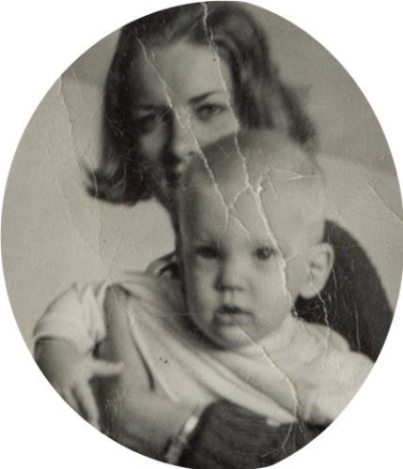
One more “difficult: person----- Me!

Slide 36
The story of two wolves

Slide 37
Conclusion

