Slide 1
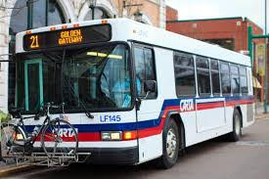
How to Ride the Bus
By Matt Weir

Slide 2
How much does it cost to ride the bus?
It depends on how you pay
One trip is $1.50 cash
24 hour unlimited ride pass is $4.00 + $2.00 for card purchase
7 day unlimited ride pass is $15.00
31 day unlimited ride pass is $50.00
Flex pass is $2.00 and can be recharged up to $30.00

Slide 3
Where can I go to get a bus pass?
A few places….
branches of First Bank: 319 Manufacturers Road,
1959 Northpoint Blvd
7442 Shallowford Road
Chattanooga Parking Authority on Market Street next to the Choo Choo,
and at CARTA bus administration office at 1617 Wilcox Boulevard

Slide 4
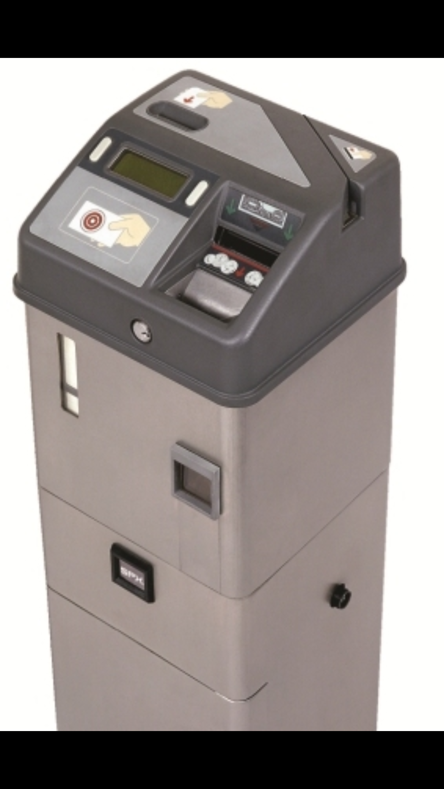
How do I use, or recharge a pass?
To use a pass,
First time use, tap the card on the bullseye
To recharge the pass
Tell the bus driver that you need to recharge the pass
Tap card
Insert cash amount of the pass. $4.00, $15.00, or $50.00
Then tap 2 more times to activate

Slide 5
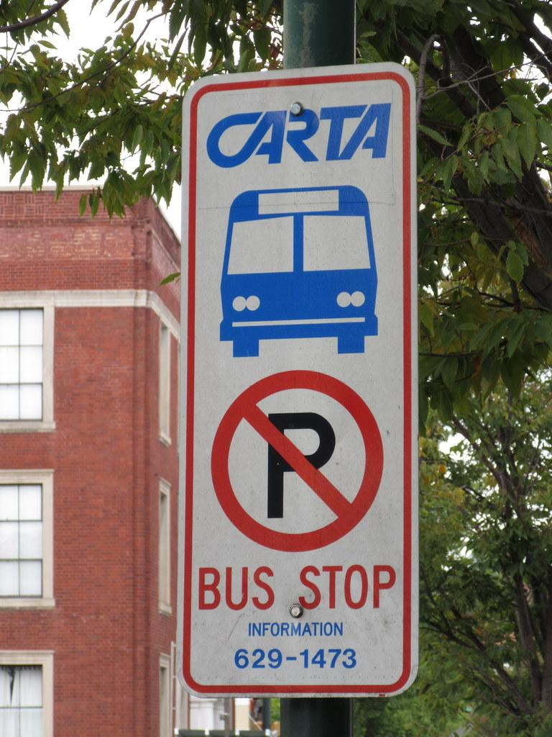
Where do I go to get the on bus?
Look for signs that look like this...

Slide 6
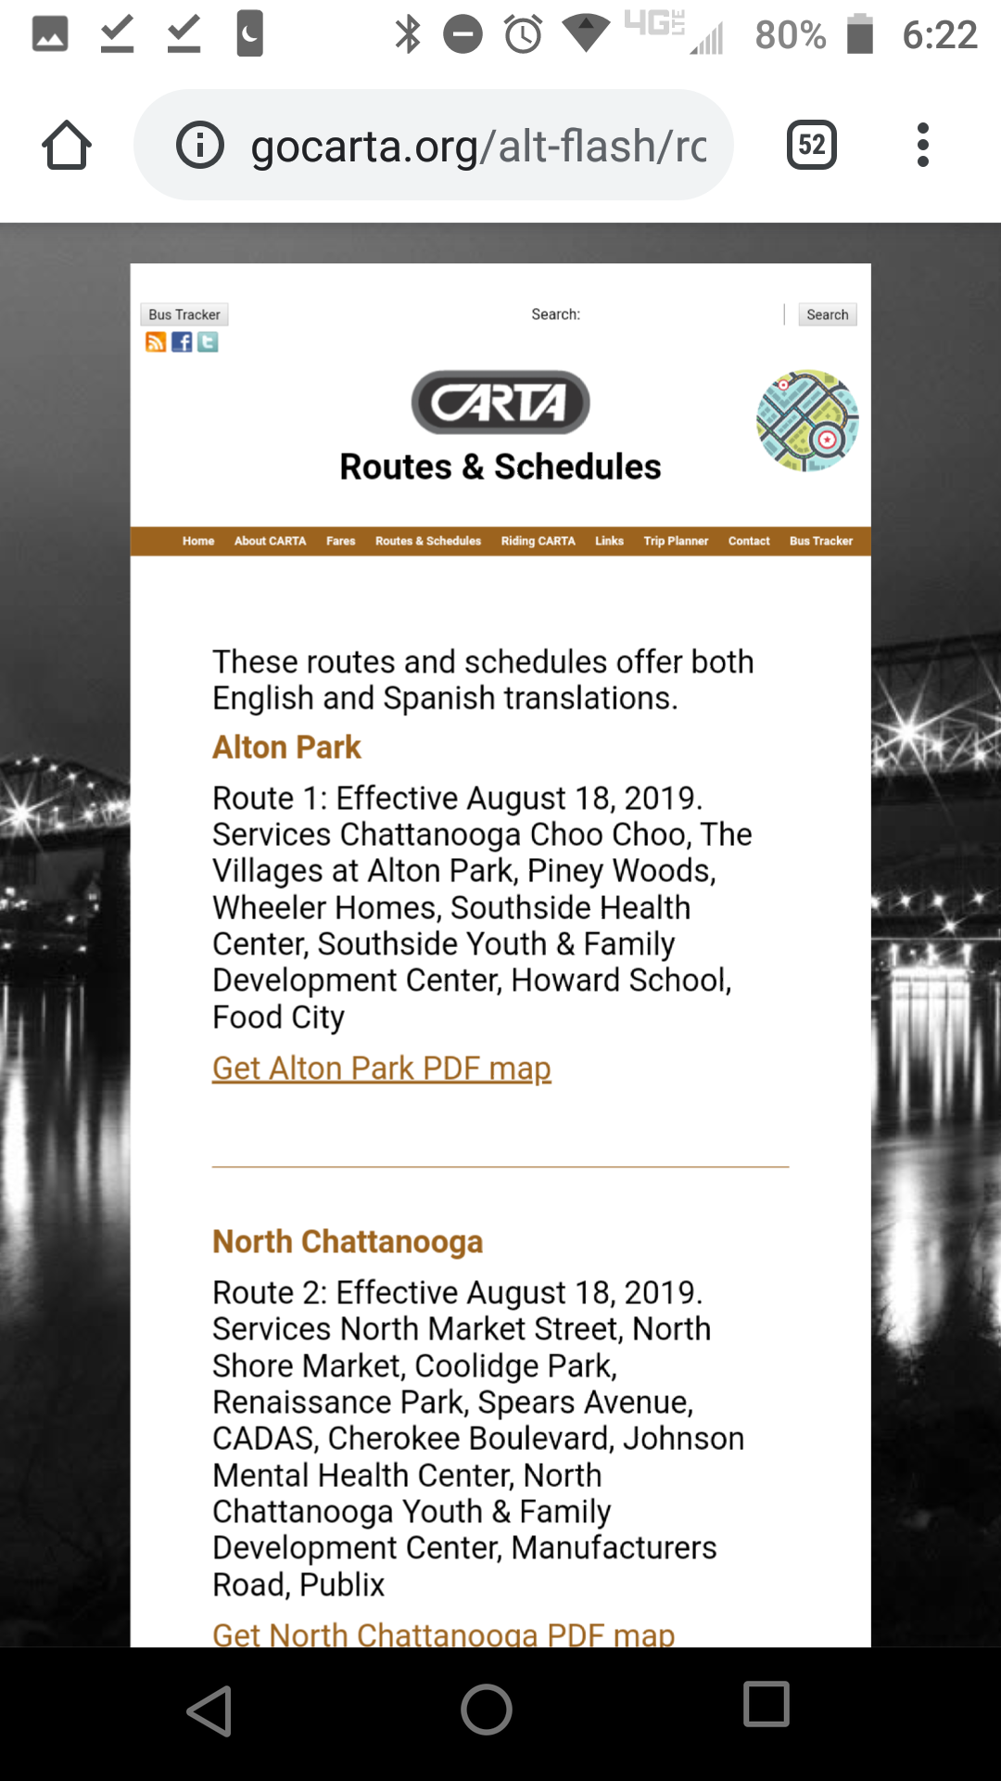
How can I access bus schedules?
A few places
On the bus
At the CARTA bus garage
On the internet at gocarta.org and click Route and schedule

Slide 7
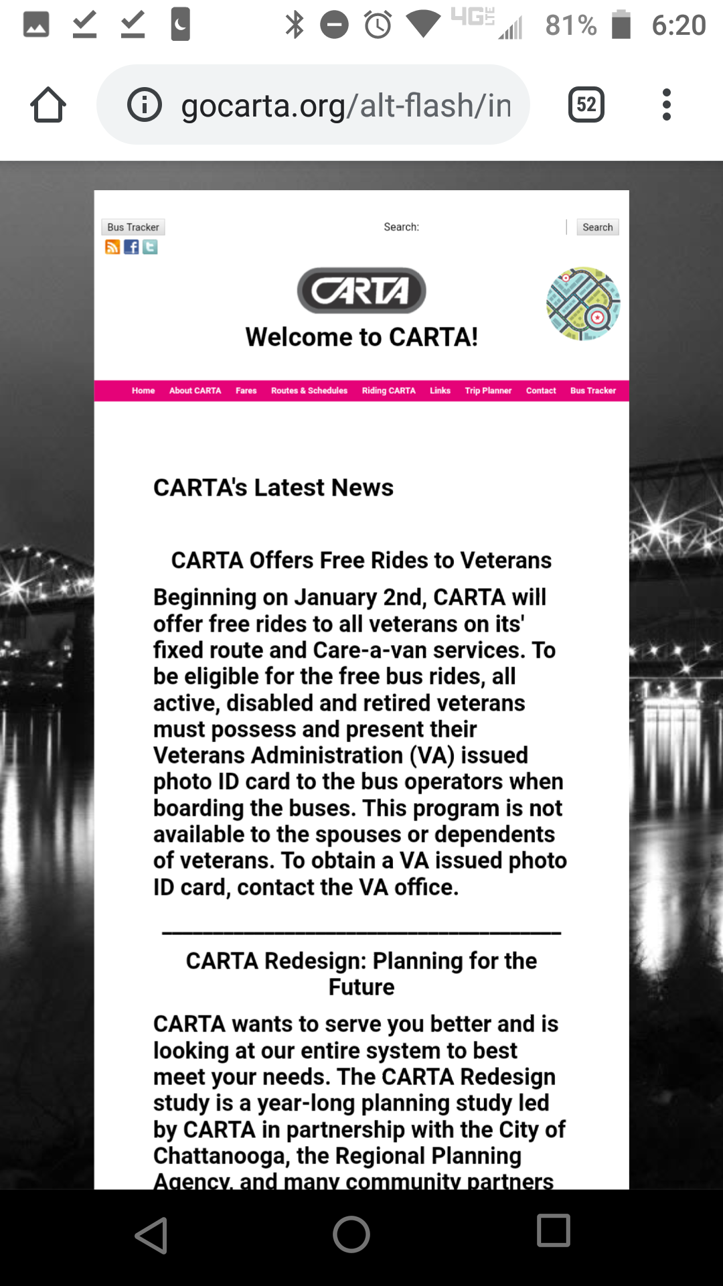
Can my bus be tracked?
The answer is yes.
Go to gocarta.org.
There you will find a button on the top left called bus tracker.

Slide 8
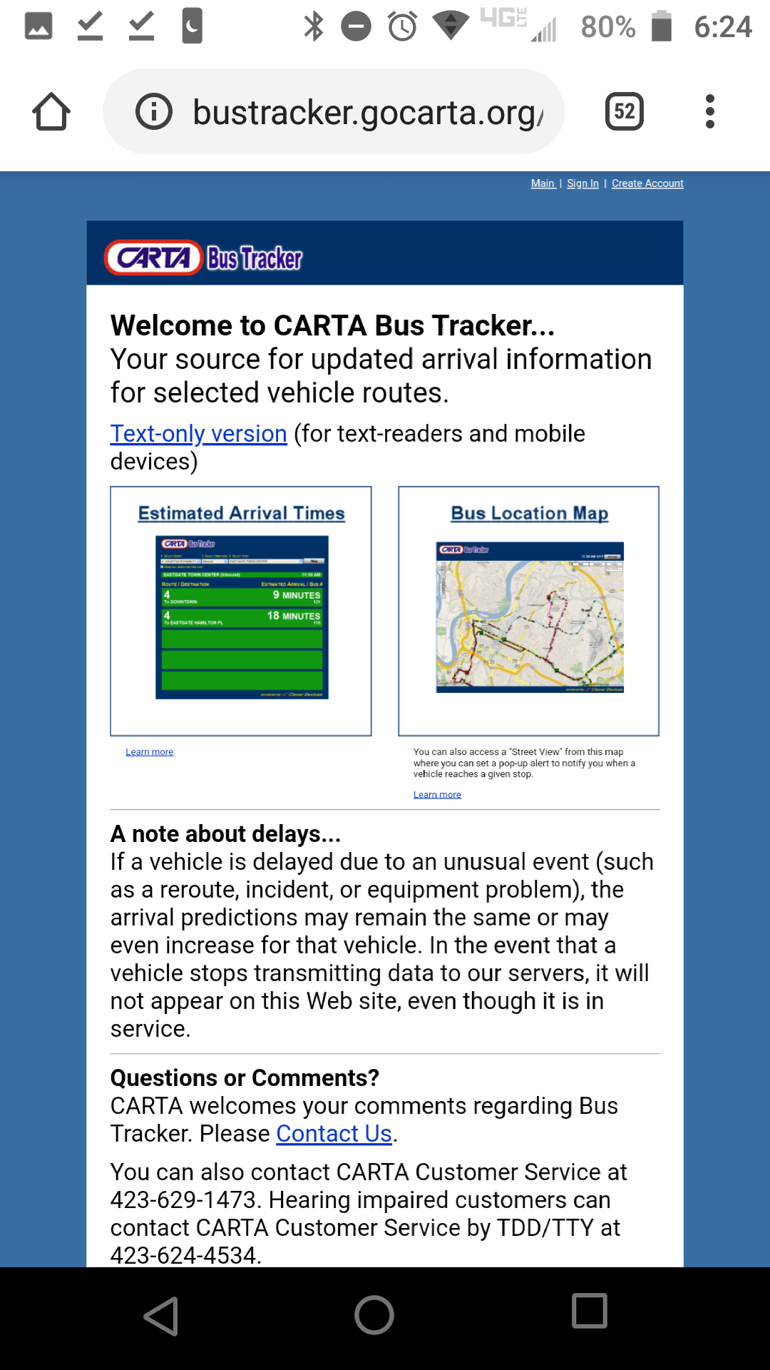
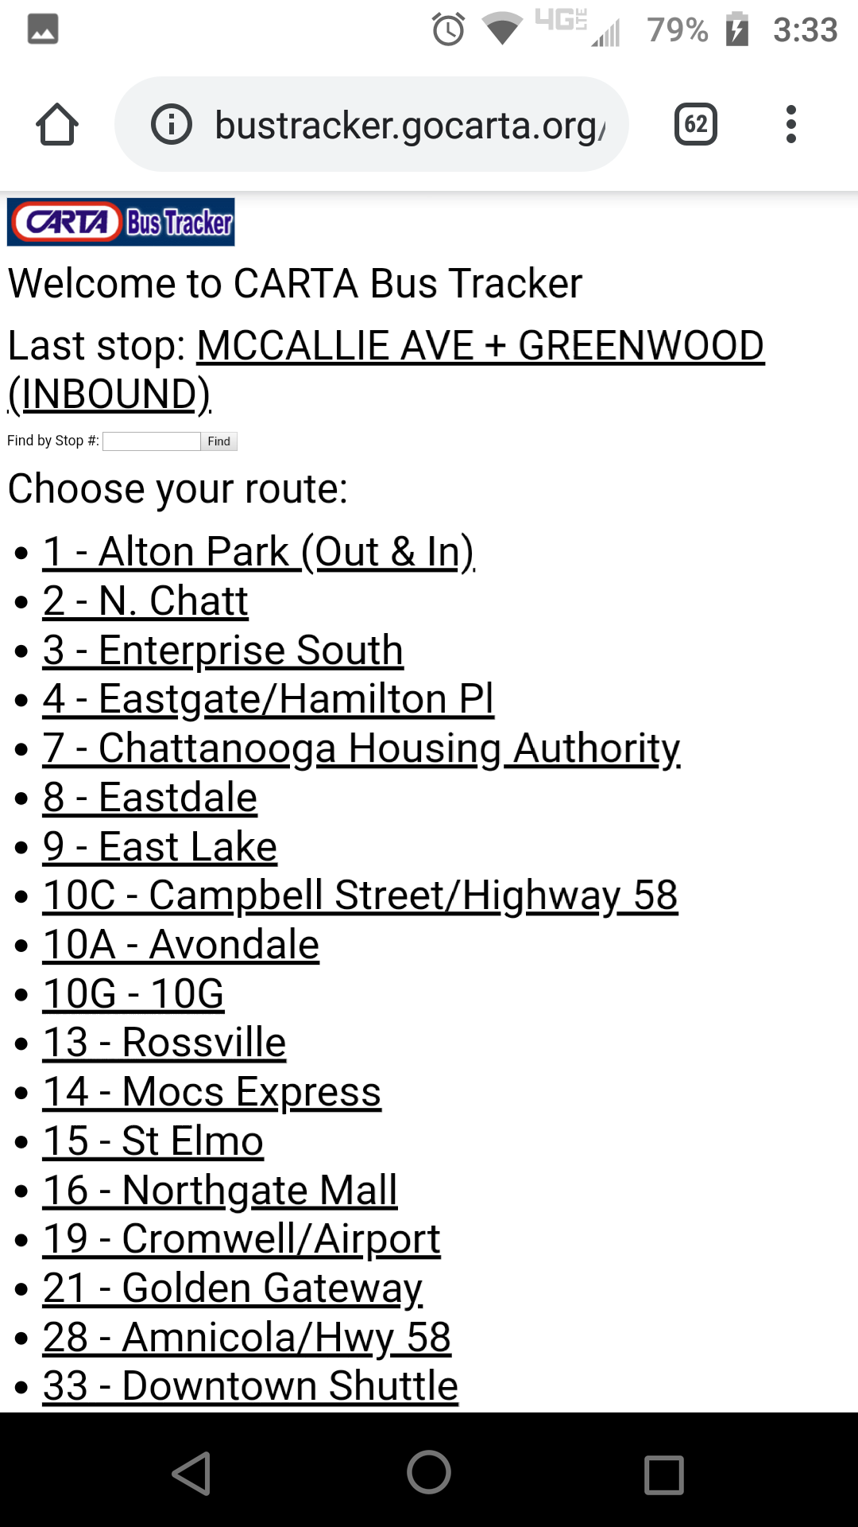
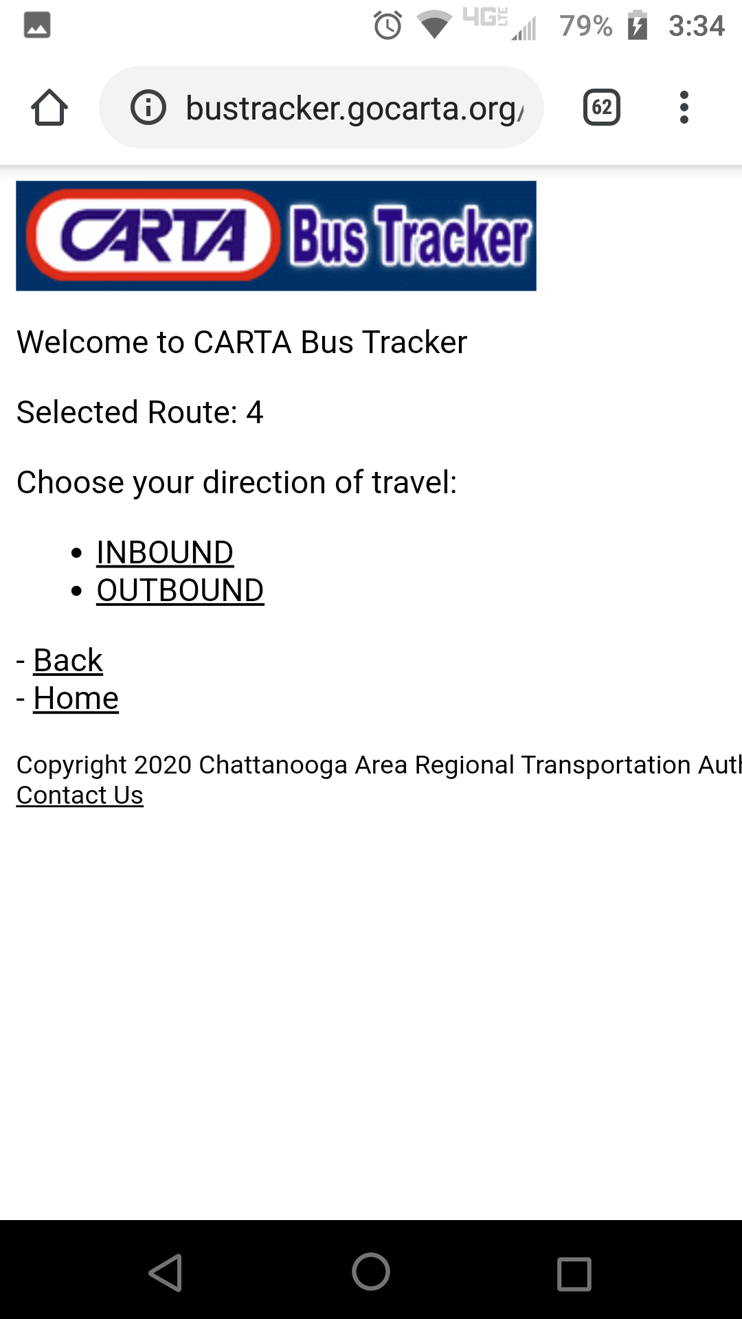

Slide 9
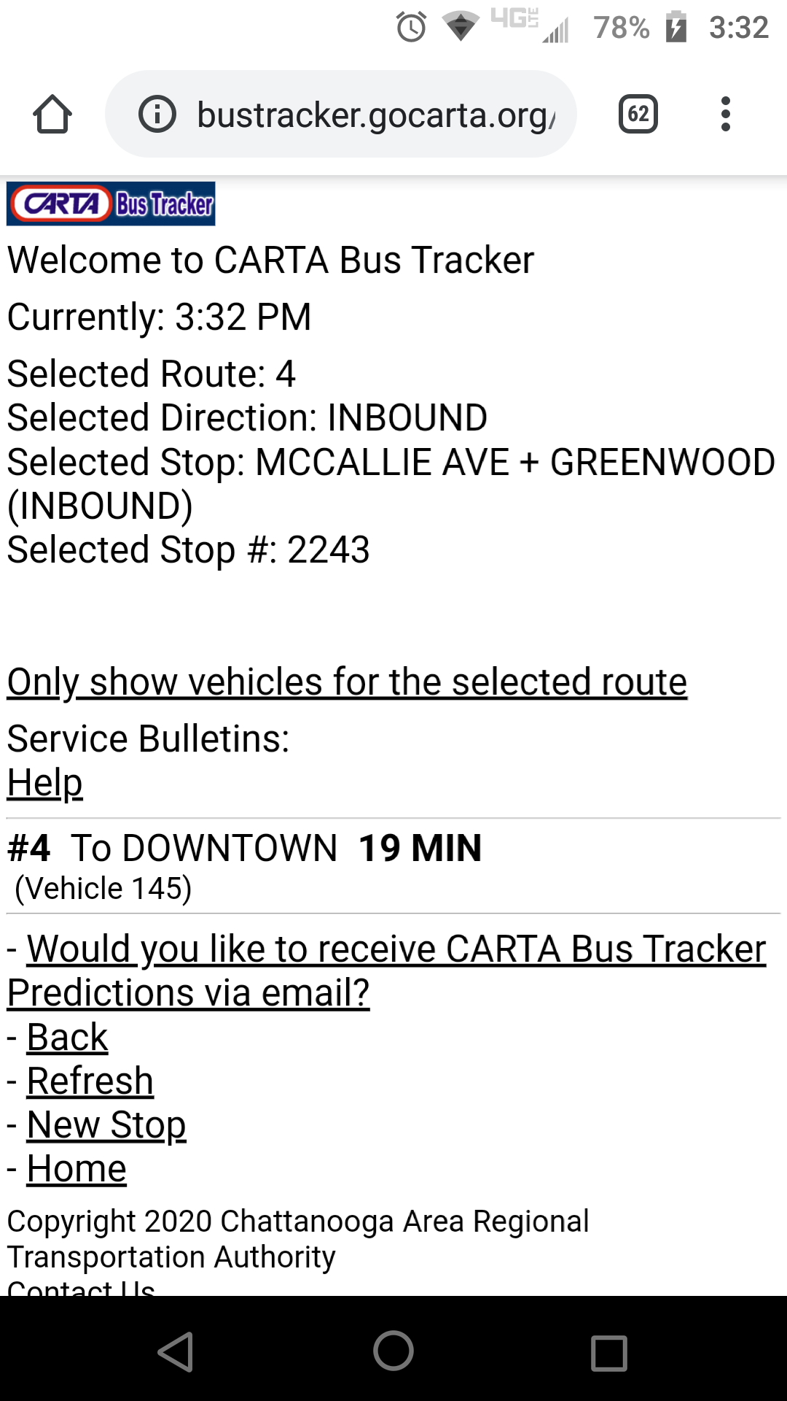
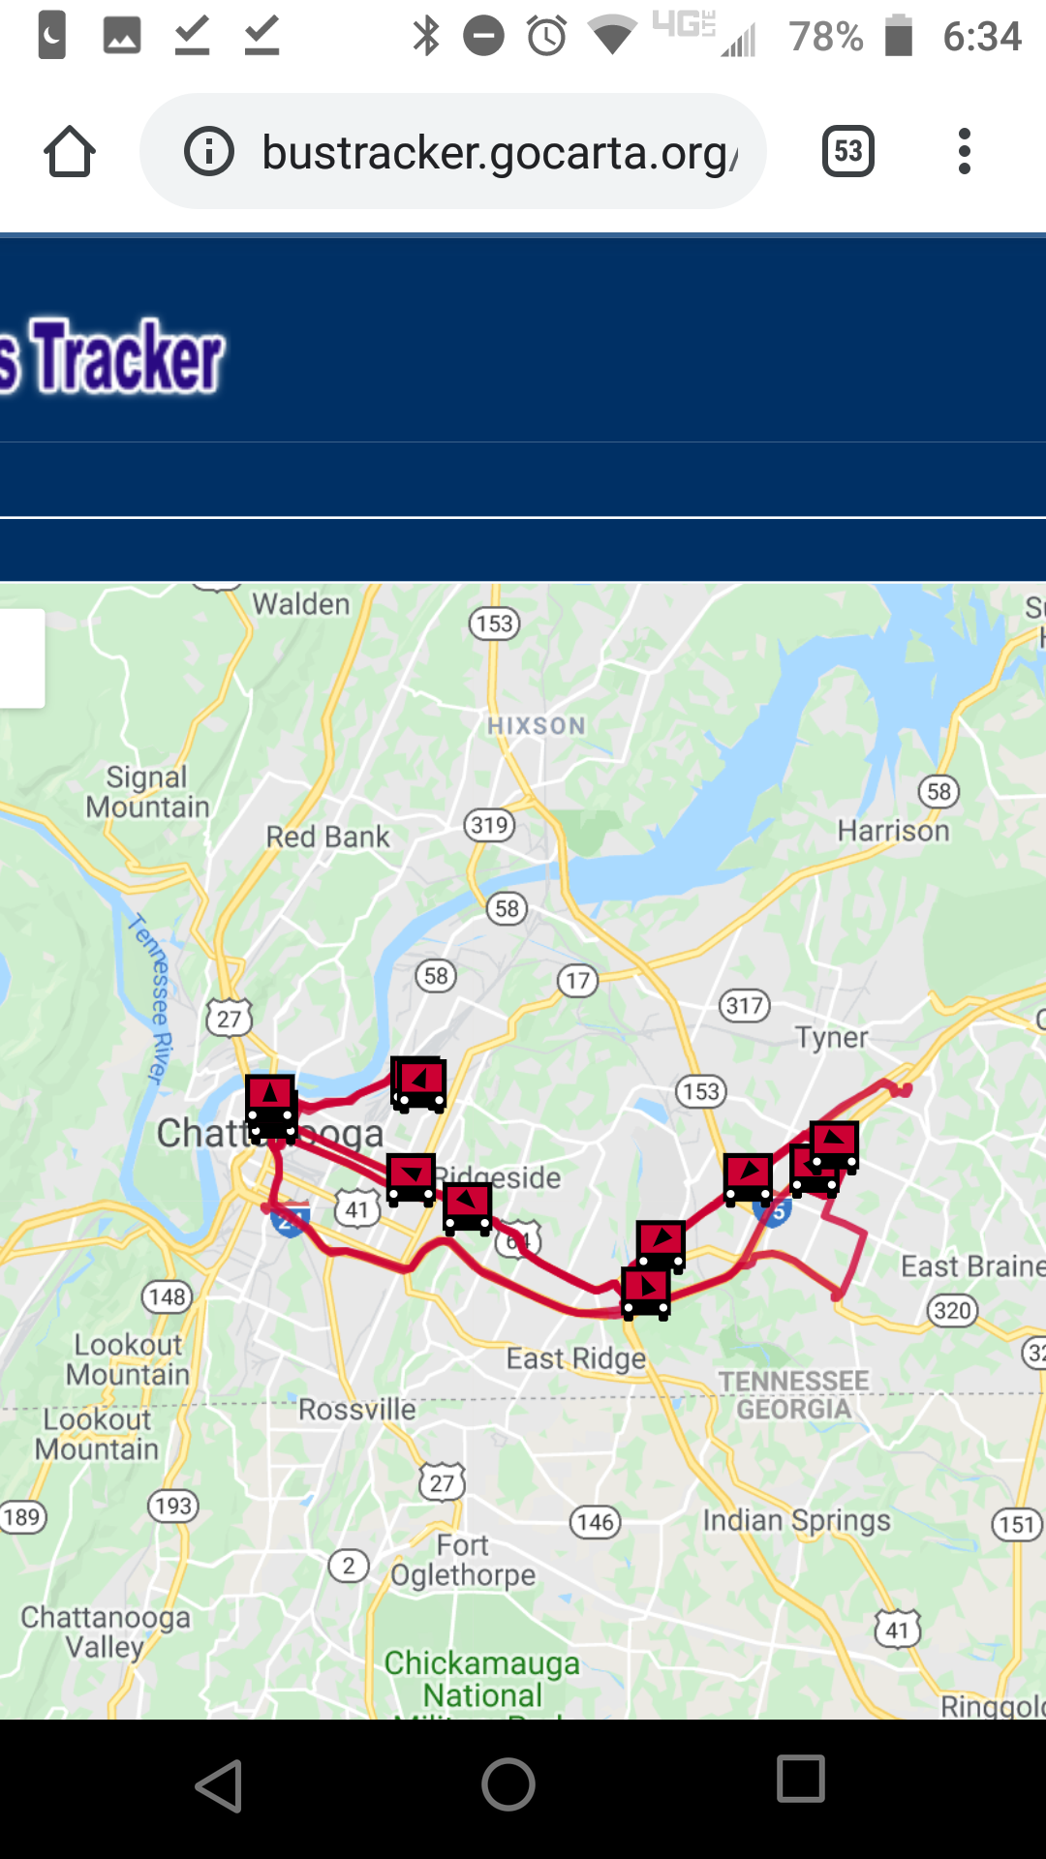

Slide 11
